Slide 1

Unit-2 Application Layer
Computer Networks (CN)
DU #2305CS332
Prof. Devangi L. Kotak
Department of Computer Application
Devangi.kotak@darshan.ac.in

Slide 2

Looping
Outline
Principles of Network Applications
Web
HTTP
Cookies, Web Cache
FTP
E-mail
SMTP
IMAP, POP3
DNS
Socket programming with TCP and UDP

Slide 3
Principles of Network Applications

Slide 4

Network Applications
A Network application is an application running on one host and provides a communication to another application running on a different host.
A network application development is writing programs that run on different end systems and communicate with each other over the network.
In the Web application there are two different programs that communicate with each other:
Browser program running in the user's host.
Web server program running in the Web server host.
Host
Host

Slide 5
Network Applications - Examples
Email
Web
Remote Login
P2P File Sharing
Multi-user Network Games
Streaming Stored Video (YouTube)
Voice Over IP (Skype)
Real-time Video Conference
Social Networking

Slide 6
Network Application Architecture
Client-Server architecture
P2P (Peer to Peer) architecture

Slide 7



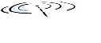






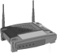




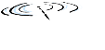


Client-Server Architecture
Server:
Its always-on host.
It has a fixed IP address.
Large cluster of host – Data Centers.
E.g. Web Server
Client:
It communicate with server.
Its not like continuously connected.
May have dynamic IP addresses.
Do not communicate directly with each other.
E.g. PCs, Mobiles
Client
Server

Slide 8
P2P Architecture
Peers (end systems) directly communicate.
Get peers request service from other peers, provide service to other peers.
Self Scalability – New peers bring new service capacity, as well as new service demands.
Peers are alternatingly connected and change IP addresses.
Complex management
Peer
Peer
Peer

Slide 9
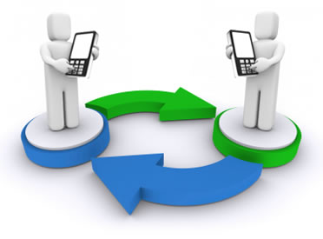
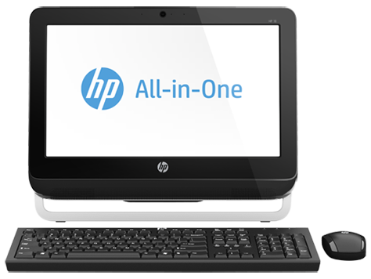
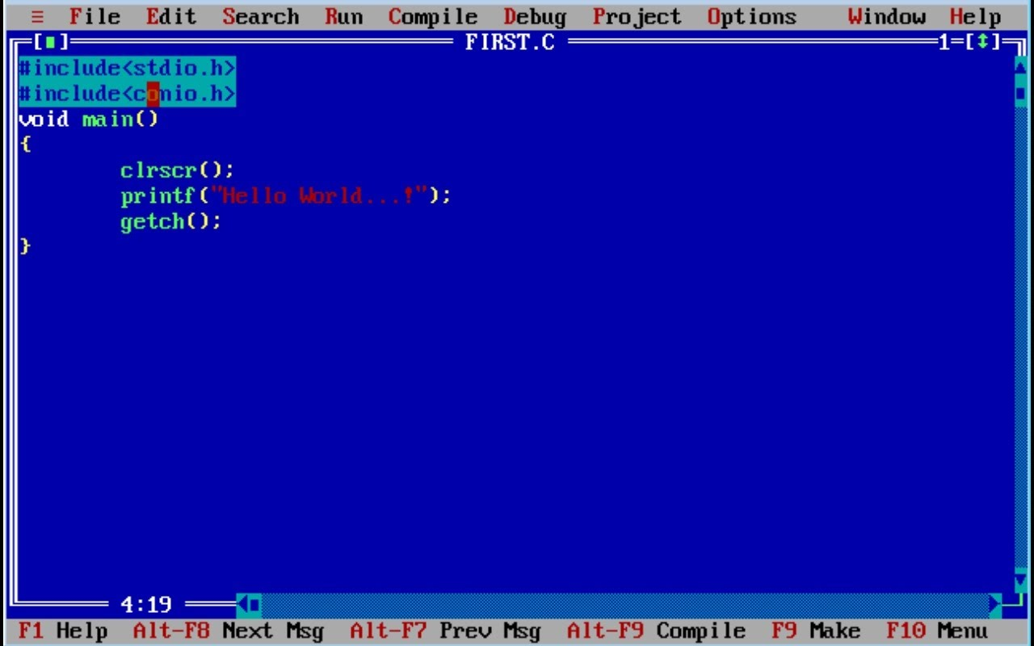
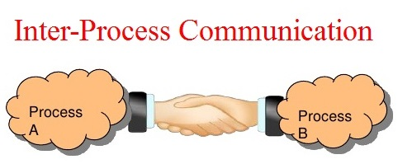

Process Communicating
What is Process?
A process is an instance of a program running in a computer.
We can say that process is program under execution.
Within same host, two processes communicate using inter-process communication (IPC).
Process in different hosts communicate by exchanging messages.
Client process: A process that initiates communication.
Server process: A process that waits to be contacted.
Process P2
Process P1

Slide 10
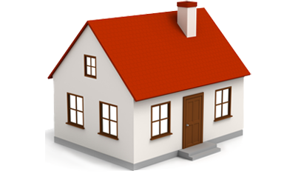


Socket
A process sends messages into and receives messages from; the network through a software interface called a socket.
A process is like a house and its socket is like its door.
Sending process passes message outdoor.
Sending process relies on transport infrastructure on other side of door to deliver message to socket at receiving process.
Process
application
socket
application
controlled by
app developer
process
process
transport
transport
network
network
controlled
by OS
link
Internet
link
Socket
physical
physical

Slide 11
Transport Services to Applications
Recall that a socket is the interface between the application process and the transport layer protocol.
For develop an application, choose available transport layer protocol.
Pick the protocol with the services that best match the needs of your application.
Example: Choose either Train or Airplane transport for travel between two cities.
Classify services with four parameters:
Reliable Data Transfer
Throughput
Timing
Security

Slide 12
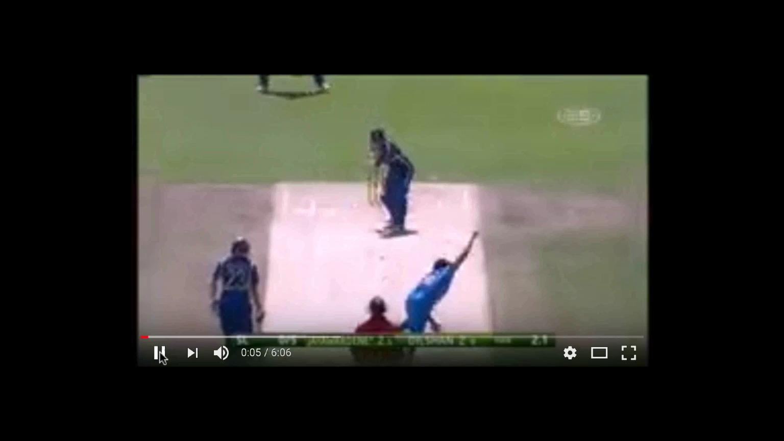
Transport Services to Applications
Reliable Data Transfer:
Many applications (e.g., email, file transfer, financial applications) require 100% reliable data transfer
Required guarantee that data sent by one end of application is delivered correctly and completely to the other end of application.
This guaranteed data delivery service is called Reliable Data Transfer.
When it will fail to deliver reliable data transfer, it is acceptable for loss-tolerant applications.
Loss-tolerant Applications (e.g., audio/video) can tolerate some loss.

Slide 13
Transport Services to Applications
Throughput
Some apps (e.g., multimedia) require at least amount of throughput to be “effective”
Bandwidth sensitive application, specific throughput required.
Elastic application can use of as much, or as little, throughput as happens to be available.
Timing
some apps (e.g., Internet telephony, interactive games) require low delay to be “effective”
Security
In the sending host, encrypt all data transmitted by the sending process.
In the receiving host, decrypt the data before delivering the data to the receiving process.

Slide 14
Internet Transport Protocols Services
TCP Service:
Connection-Oriented: A setup required between client and server processes
Reliable data transfer between sending and receiving process without error and proper order
Congestion control: To control sender when network overloaded
Examples: HTTP, HTTPS, FTP, Telnet, SSH
UDP Services:
Connectionless: No connection before two processes start to communicate.
Unreliable data transfer between sending and receiving process
It does not provide congestion control.
Examples: Online games, audio/video streaming (e.g.,RealPlayer), Live broadcast

Slide 15
Internet Applications
Popular internet applications with their application layer and their underlying transport protocol.
Applications | Application-Layer Protocol | Underlying Transport Protocol (Service)
Email | SMTP | TCP
Remote Terminal | Telnet | TCP
No loss,
Elastic Bandwidth
Web | HTTP | TCP
File Transfer | FTP | TCP
Streaming Media | HTTP(YouTube), RTP | TCP or UDP
Loss-tolerant
Internet Telephony | SIP, RTP(Skype) | Typically UDP

Slide 16
Web & HTTP

Slide 17
Web
Early 1990, Internet was used only by researchers, academics, and university students.
New application WWW arrived in 1994 by Tim Berners-Lee.
World Wide Web - is an information where documents and other web resources are identified by URL, interlinked by hypertext links, and can be accessed via the Internet.
On demand available, What they want, When they want it.
Unlike TV and Radio.
Navigate through Websites.

Slide 18
Web and HTTP
Web page consists of objects.
Object can be HTML file, JPEG image, Java applet, audio file etc.…
Web page consists of base HTML-file which includes several referenced objects.
Each object is addressable by a Uniform Resource Locator (URL), like;
Web Page (e.g Total five objects)
www.someschool.edu/someDept/pic.gif
host name
path name

Slide 19
HTTP
HyperText Transfer Protocol – Application layer protocol
It is implemented in two programs.
Client Program
Server Program
Exchanging HTTP message each others.
HTTP defines the structure of these messages and how web client – web server exchange messages.
HTTP
Request
HTTP Response

Slide 20

HTTP – Cont…
HTTP
Hyper-Text Transfer Protocol
It is Application layer protocol
Client: A browser that requests, receives, (using HTTP protocol) and “displays” Web objects.
E.g. PC, Mobile
Server: Web server sends (using HTTP protocol) objects in response to requests.
E.g. Apache Web Server
PC
(Web Browser)
HTTP request
HTTP response
HTTP request
Server
(Apache Web
Server)
HTTP response
Mobile
(Web Browser)

Slide 21
HTTP - Cont...
A client initiates TCP connection (creates socket) to server using port 80.
A server accepts TCP connection from client.
HTTP messages (application-layer protocol messages) exchanged between browser (HTTP client) and Web server (HTTP server).
HTTP is “stateless protocol”, server maintains no information about past client requests.
HTTP connection types are:
Non-persistent HTTP
Persistent HTTP

Slide 22
Non-persistent HTTP & Persistent HTTP Connection

Slide 23
Non-persistent & Persistent Connection
In Client-Server communication, Client making a series of requests to server, Server responding to each of the requests.
Series of requests may be made back-to-back or periodically at regular time interval.
So, Application developer need to make an important decision;
Should each request/response pair be sent over a separate TCP connection.
OR should all the requests and corresponding responses be sent over same TCP connection?

Slide 24
Non-persistent HTTP
A non-persistent connection is closed after the server sends the requested object to the client.
The connection is used exactly for one request and one response.
For downloading multiple objects, it required multiple connections.
Non-persistent connections are the default mode for HTTP/1.0.
Example:
Transferring a webpage from server to client, webpage consists of a base HTML file and 10 JPEG images.
Total 11 object are residing on server.

Slide 25
Non-persistent HTTP – Cont.…
www.someSchool.edu/someDepartment/home.index
URL:
1a. HTTP client initiates TCP connection to HTTP server (process) at www.someSchool.edu on port 80
1b. HTTP server at host www.someSchool.edu waiting for TCP connection at port 80. “accepts” connection, notifying client
2. HTTP client sends HTTP request message (containing URL) into TCP connection socket. Message indicates that client wants object someDepartment/home.index
3. HTTP server receives request message, forms response message containing requested object, and sends message into its socket
4. HTTP server closes TCP connection.
5. HTTP client receives response message containing html file, displays html. Parsing html file, finds 10 referenced jpeg objects
Time
6. Steps 1-5 repeated for each of 10 jpeg objects

Slide 26
Non-persistent HTTP: Response time
RTT(round-trip time): A time for a small packet to travel from client to server and vice versa.
HTTP response time:
One RTT to initiate TCP connection.
One RTT for HTTP request and first few bytes of HTTP response to return.
File transmission time
initiate TCP
connection
Non-persistent HTTP response time =
2RTT
+
file transmission time
RTT
request
file
RTT
time to
transmit
file
file
received
time
time

Slide 27
Persistent HTTP
Server leaves the TCP connection open after sending responses.
Subsequent HTTP messages between same client and server sent over open connection.
The server closes the connection only when it is not used for a certain configurable amount of time.
It requires as little as one round-trip time (RTT) for all the referenced objects.
With persistent connections, the performance is improved by 20%.
Persistent connections are the default mode for HTTP/1.1.

Slide 28
HTTP Message Format
Two types:
Request Message
Response Message

Slide 29
HTTP Request Message
It is in ASCII format which means that human-readable format.
HTTP request message consist three part:
Request line
Header line
Carriage return
carriage return character
request line
(GET, POST,
HEAD commands)
line-feed character
GET /index.html HTTP/1.1\r\n
Host: www-net.cs.umass.edu\r\n
User-Agent: Firefox/3.6.10\r\n
Accept: text/html,application/xhtml+xml\r\n
Accept-Language: en-us,en;q=0.5\r\n
Accept-Encoding: gzip,deflate\r\n
Accept-Charset: ISO-8859-1,utf-8;q=0.7\r\n
Keep-Alive: 115\r\n
Connection: keep-alive\r\n
\r\n
header
lines
carriage return
(line feed at start
of line indicates
end of header lines)

Slide 30
HTTP Request Message - Format
The request line has three fields: Method field, URL field, and HTTP version field.
The method field can take on several different values, including GET, POST, HEAD, PUT, and DELETE.
In above message, browser is requesting the object /somedir/page.html and version is self-explanatory; browser implements version HTTP/1.1.
The header line Host: www-net.cs.umass.edu specifies the host on which the object resides.
User agent indicate browser name and version.

Slide 31
HTTP Response Message
HTTP response message consist of three part:
Status line
Header line
Data (Entity body)
status line
(protocol
status code
status phrase)
HTTP/1.1 200 OK\r\n
Date: Sun, 26 Sep 2010 20:09:20 GMT\r\n
Server: Apache/2.0.52 (CentOS)\r\n
Last-Modified: Tue, 30 Oct 2007 17:00:02 GMT\r\n
ETag: "17dc6-a5c-bf716880"\r\n
Accept-Ranges: bytes\r\n
Content-Length: 2652\r\n
Keep-Alive: timeout=10, max=100\r\n
Connection: Keep-Alive\r\n
Content-Type: text/html; charset=ISO-8859-1\r\n
\r\n
data data data data data ...
header
lines
data, e.g.,
requested
HTML file

Slide 32
HTTP Response Message - Format
The status line has three fields: protocol version field, status code and corresponding status message.
In below example, the status line indicates that the server is using HTTP/1.1 and that everything is OK.
HTTP/1.1 200 OK\r\n
Date: Sun, 26 Sep 2010 20:09:20 GMT\r\n
Server: Apache/2.0.52 (CentOS)\r\n
Last-Modified: Tue, 30 Oct 2007 17:00:02 GMT\r\n
ETag: "17dc6-a5c-bf716880"\r\n
Accept-Ranges: bytes\r\n
Content-Length: 2652\r\n
Keep-Alive: timeout=10, max=100\r\n
Connection: Keep-Alive\r\n
Content-Type: text/html; charset=ISO-8859-1\r\n \r\n
data data data data data ...
Date: header line indicates the time and date when the HTTP response was created and sent by the server.

Slide 33
HTTP Response Message - Format
The status line has three fields: protocol version field, status code and corresponding status message.
In below example, the status line indicates that the server is using HTTP/1.1 and that everything is OK.
HTTP/1.1 200 OK\r\n
Date: Sun, 26 Sep 2010 20:09:20 GMT\r\n
Server: Apache/2.0.52 (CentOS)\r\n
Last-Modified: Tue, 30 Oct 2007 17:00:02 GMT\r\n
ETag: "17dc6-a5c-bf716880"\r\n
Accept-Ranges: bytes\r\n
Content-Length: 2652\r\n
Keep-Alive: timeout=10, max=100\r\n
Connection: Keep-Alive\r\n
Content-Type: text/html; charset=ISO-8859-1\r\n \r\n
data data data data data ...
Date: header line indicates the time and date when the HTTP response was created and sent by the server.
Server: header line indicates that the message was generated by an Apache Web server.
Last-Modified: header line indicates the time and date when the object was created or last modified.
Content-Length: header line indicates the number of bytes in the object being sent.
Content-Type: header line indicates that the object in the entity body is HTML text.

Slide 34
HTTP Response Message - Format
The status line has three fields: protocol version field, status code and corresponding status message.
In below example, the status line indicates that the server is using HTTP/1.1 and that everything is OK.
HTTP/1.1 200 OK\r\n
Date: Sun, 26 Sep 2010 20:09:20 GMT\r\n
Server: Apache/2.0.52 (CentOS)\r\n
Last-Modified: Tue, 30 Oct 2007 17:00:02 GMT\r\n
ETag: "17dc6-a5c-bf716880"\r\n
Accept-Ranges: bytes\r\n
Content-Length: 2652\r\n
Keep-Alive: timeout=10, max=100\r\n
Connection: Keep-Alive\r\n
Content-Type: text/html; charset=ISO-8859-1\r\n \r\n
data data data data data ...
Date: header line indicates the time and date when the HTTP response was created and sent by the server.
Server: header line indicates that the message was generated by an Apache Web server.
Last-Modified: header line indicates the time and date when the object was created or last modified.
Content-Length: header line indicates the number of bytes in the object being sent.
Content-Type: header line indicates that the object in the entity body is HTML text.

Slide 35
HTTP Response Message - Format
The status line has three fields: protocol version field, status code and corresponding status message.
In below example, the status line indicates that the server is using HTTP/1.1 and that everything is OK.
HTTP/1.1 200 OK\r\n
Date: Sun, 26 Sep 2010 20:09:20 GMT\r\n
Server: Apache/2.0.52 (CentOS)\r\n
Last-Modified: Tue, 30 Oct 2007 17:00:02 GMT\r\n
ETag: "17dc6-a5c-bf716880"\r\n
Accept-Ranges: bytes\r\n
Content-Length: 2652\r\n
Keep-Alive: timeout=10, max=100\r\n
Connection: Keep-Alive\r\n
Content-Type: text/html; charset=ISO-8859-1\r\n \r\n
data data data data data ...
Date: header line indicates the time and date when the HTTP response was created and sent by the server.
Server: header line indicates that the message was generated by an Apache Web server.
Last-Modified: header line indicates the time and date when the object was created or last modified.
Content-Length: header line indicates the number of bytes in the object being sent.
Content-Type: header line indicates that the object in the entity body is HTML text.

Slide 36
HTTP Response Message - Format
The status line has three fields: protocol version field, status code and corresponding status message.
In below example, the status line indicates that the server is using HTTP/1.1 and that everything is OK.
HTTP/1.1 200 OK\r\n
Date: Sun, 26 Sep 2010 20:09:20 GMT\r\n
Server: Apache/2.0.52 (CentOS)\r\n
Last-Modified: Tue, 30 Oct 2007 17:00:02 GMT\r\n
ETag: "17dc6-a5c-bf716880"\r\n
Accept-Ranges: bytes\r\n
Content-Length: 2652\r\n
Keep-Alive: timeout=10, max=100\r\n
Connection: Keep-Alive\r\n
Content-Type: text/html; charset=ISO-8859-1\r\n \r\n
data data data data data ...
Date: header line indicates the time and date when the HTTP response was created and sent by the server.
Server: header line indicates that the message was generated by an Apache Web server.
Last-Modified: header line indicates the time and date when the object was created or last modified.
Content-Length: header line indicates the number of bytes in the object being sent.
Content-Type: header line indicates that the object in the entity body is HTML text.

Slide 37
HTTP Response Status Codes
A status code appears in 1st line in server-to-client response message.
Some sample codes:
200 OK
Request succeeded, requested object later in this message
301 Moved Permanently
Requested object moved, new location specified later in this message(Location)
400 Bad Request
Request message not understood by server
404 Not Found
Requested document not found on this server
505 HTTP Version Not Supported
Requested http version not support

Slide 38
Cookie & Web Cache

Slide 39
User-Server interactions: Cookie
A small text file that is stored in the user's computer either temporarily for that session only or permanently on the hard disk.
Cookies provide a way for the Web site to recognize you and keep track of your preferences.
The cookie technology has four components:
A cookie header line in the HTTP response message
A cookie header line in the HTTP request message
A cookie file kept on the user’s end system and managed by the user’s browser
A back-end database at the Web site
Use of Cookies
Authorization
Recommendations
User session state (Web, Email)
Shopping carts

Slide 40


Slide 41
Cookies - Example
client
server
ebay 8734
usual http request msg
server
creates ID
1678 for user
cookie file
usual http response
set-cookie: 1678
backend
database
create
entry
ebay 8734
amazon 1678
usual http request msg
cookie: 1678
cookie-
specific
action
access
usual http response msg
one week later:
access
ebay 8734
amazon 1678
usual http request msg
cookie: 1678
cookie-
specific
action
usual http response msg

Slide 42

Web Caches (Proxy Server)
It satisfies HTTP requests on the behalf of an origin Web server.
The Web cache has its own disk storage and keeps copies of recently requested objects in this storage.
proxy
server
HTTP request
HTTP request
client
origin
server
HTTP response
HTTP response
HTTP request
HTTP response
client
origin
server

Slide 43
Web Caches (Proxy Server) – Cont...
A user’s browser can be configured so, user’s HTTP requests are first directed to the Web Cache.
A browser sends all HTTP requests to cache.
Suppose a browser is requesting the object: http://www.someschool.edu/campus.gif
Object in cache returns to client browser.
Otherwise cache requests object from origin server, then returns object to client browser.

Slide 44
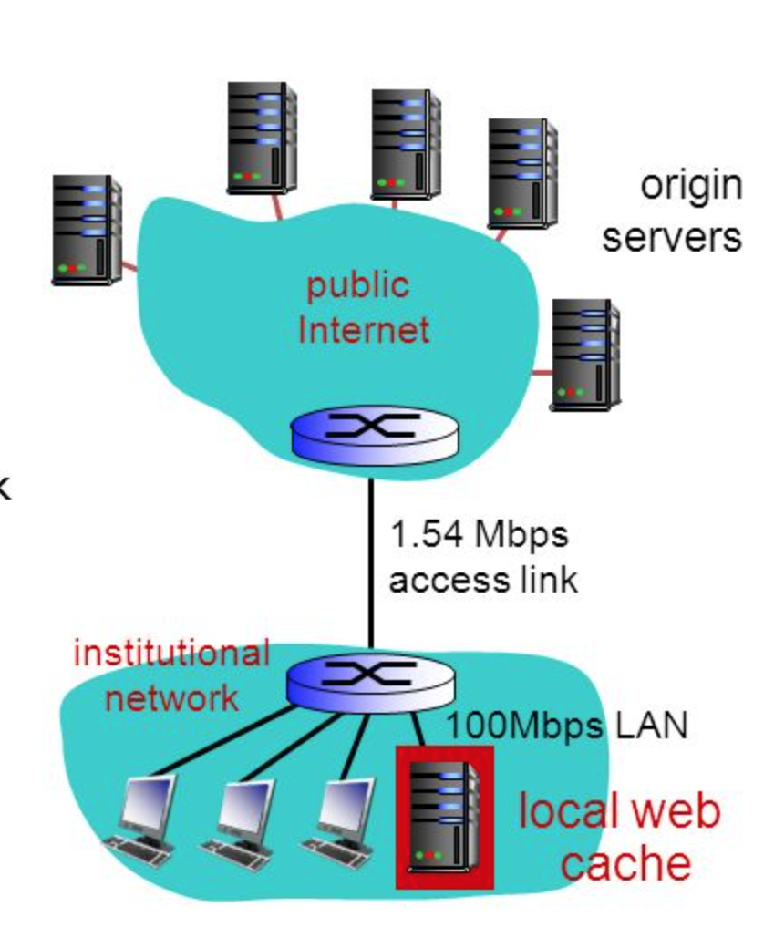
Web Caches (Proxy Server) – Example
Example: Institutional Network and Internet
Reduce response time for client request.
Reduce traffic on an institution’s access link.
Internet dense with caches: Insufficiency for content providers to effectively deliver content.

Slide 45
Computer Networks (CN)
DU #2305CS332
Prof. Devangi L. Kotak
Department of Computer Application
Devangi.kotak@darshan.ac.in

